Slide 1
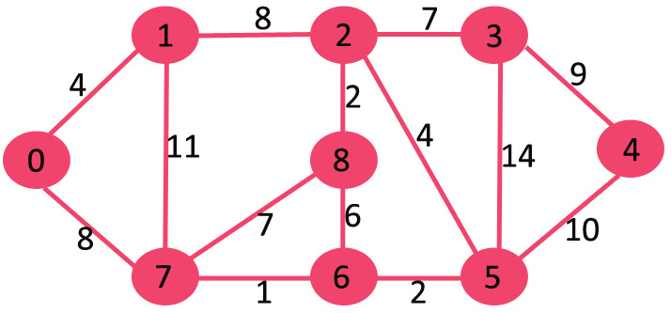
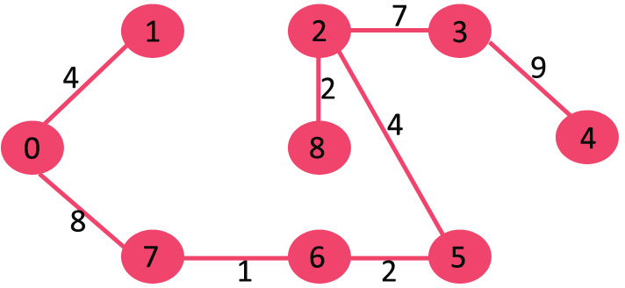
KRUSKAL’S ALGORITHM
1. Sort all the edges in non-decreasing order of their weight.
2. Pick the smallest edge. Check if it forms a cycle with the spanning tree formed so far. If cycle is not formed, include this edge. Else, discard it.
3. Repeat step#2 until there are (V-1) edges in the spanning tree.

Slide 2
PSEUDU CODE
MST- KRUSKAL(G):
1 A = ∅
2 foreach v ∈ G.V:
3 MAKE-SET(v)
4 foreach (u, v) in G.E ordered by weight(u, v), increasing:
5 If FIND-SET(u) ≠ FIND-SET(v):
6 A = A ∪ {(u, v)}
7 UNION(u, v)
8 return A
O(1)
2,3. A Very Slowly Growing Function O(ElogE) or
4. O(E log (E)) O(ElogV)
5,6,7,8. O(E log(V))

Slide 3
KRUSKAL’S ALGORITHM FOR A BIG GRAPH(MORE VERTICES)

Slide 4
PRIM’S ALGORITHM
1) Create a set mstSet that keeps track of vertices already included in MST.
2) Assign a key value to all vertices in the input graph. Initialize all key values as INFINITE. Assign key value as 0 for the first vertex so that it is picked first.
3) While mstSet doesn’t include all vertices ….a) Pick a vertex u which is not there in mstSet and has minimum key value. ….b) Include u to mstSet. ….c) Update key value of all adjacent vertices of u. To update the key values, iterate through all adjacent vertices. For every adjacent vertex v, if weight of edge u-v is less than the previous key value of v, update the key value as weight of u-v

Slide 5
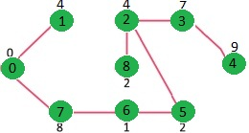
example

Slide 6

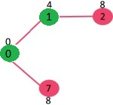
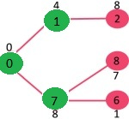
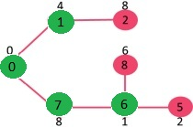
STEPS IN BETWEEN

Slide 7
HOW IT WORKS(DEMO)

Slide 8
TIME COMPLEXITY
The complexity of prim’s is O(V^2) if Adjacency matrix is used.
If Adjacency list is used then O(Elog(V)).

